Slide 1

Neutrino Interactions and Future Experiments
LU Xianguo 卢显国
University of Warwick
PRISMA+ Colloquium
2025 April 23, Universität Mainz

Slide 2
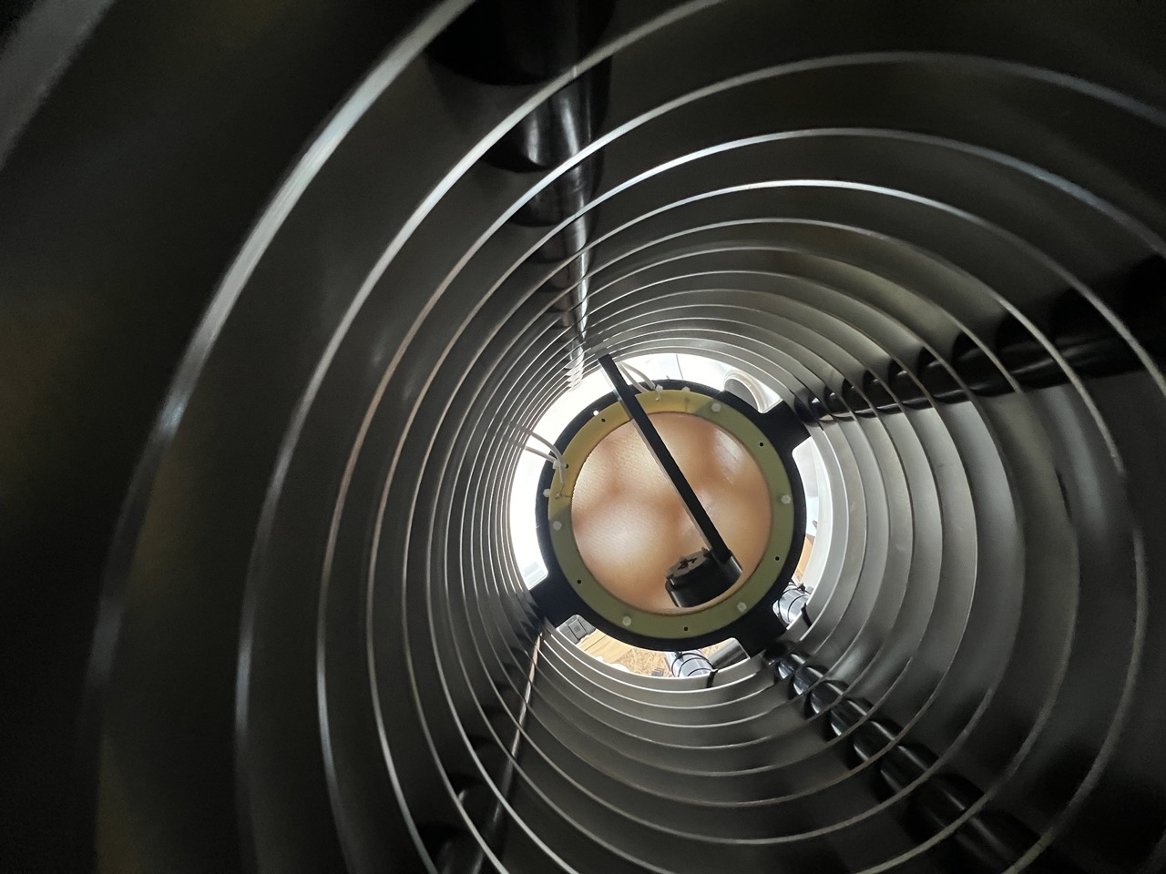
About me
Moiré pattern of overlapping thick GEMs
Photo by Alexander Deisting at WarTPC
BSc: Peking University
  DESY Summer School
Diplom-Physiker: Hamburg
  Maria Laach Herbstschule
Dr. rer. nat.: Heidelberg
  PhD in ALICE experiment
Postdoc: Heidelberg, Oxford (w/ Alfons Weber)
  Accelerator-neutrino experiments
  Tutor in Pembroke College
Faculty: Oxford, Warwick
  Ernest Rutherford Fellow, Asst., Assoc. Prof.
  Neutrino interactions exp & pheno.
  WarTPC lab for new TPC technology
  Future neutrino facility: nuSTORM
  First UK group in JUNO neutrino experiment

Slide 3
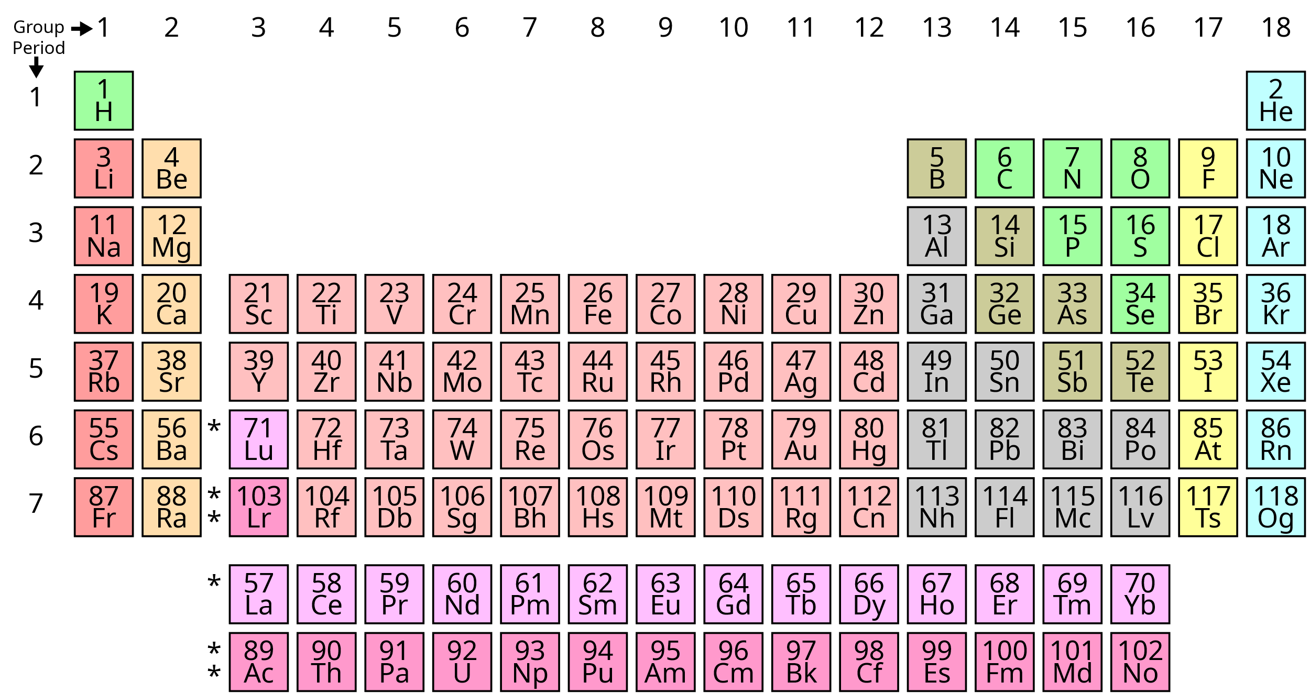
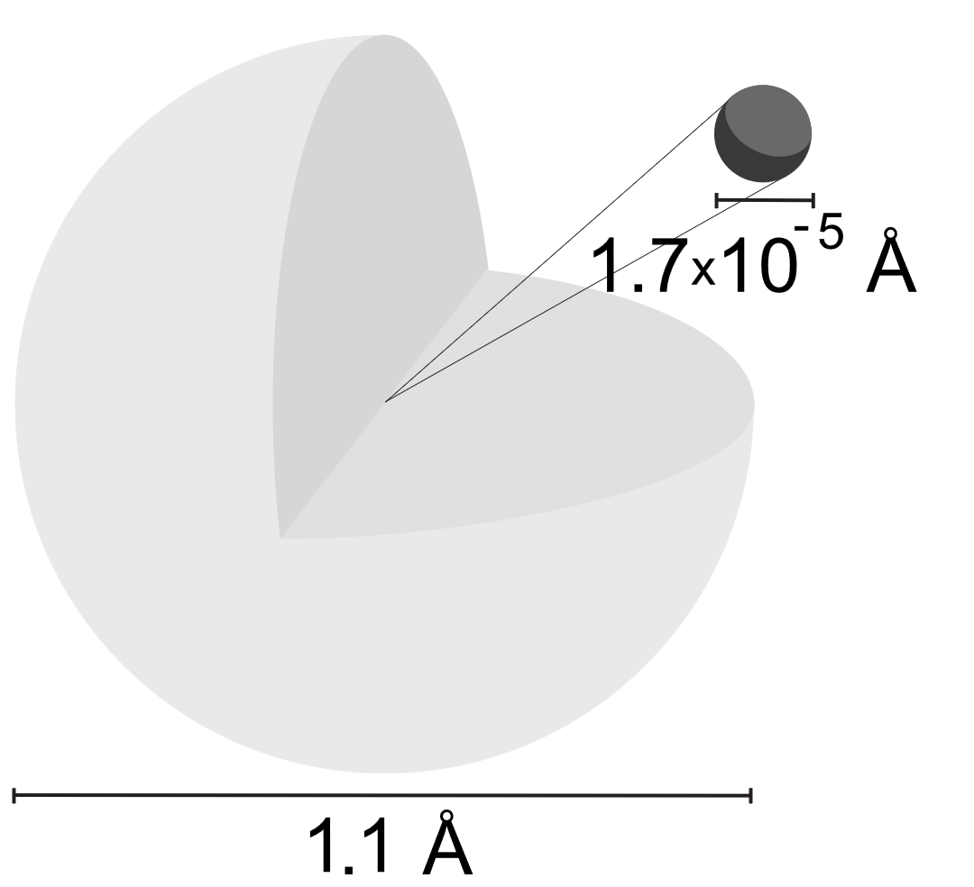
Elements
(Mendeleev, 1869)
Atom
Nucleus (Rutherford, 1911)
Electron (J. J. Thomson, 1897)
H-1

Slide 4
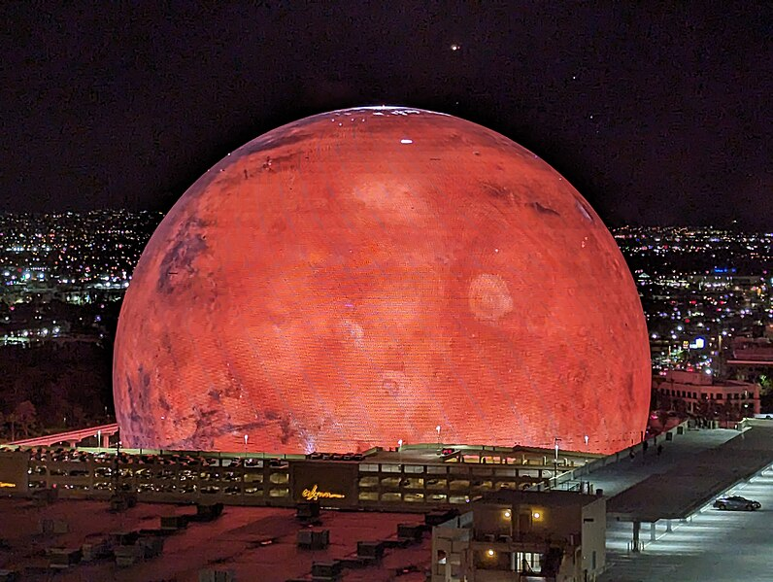
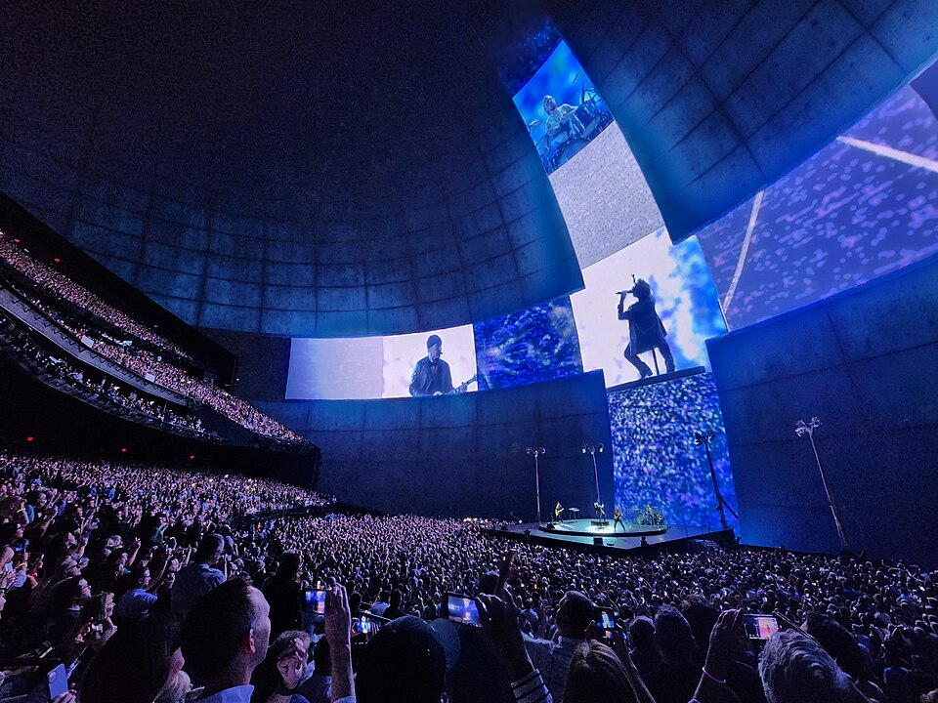
Atom ~ The Sphere
Nucleus ~ 1 mm
157 m
Source: https://en.wikipedia.org/wiki/Sphere_(venue)

Slide 5
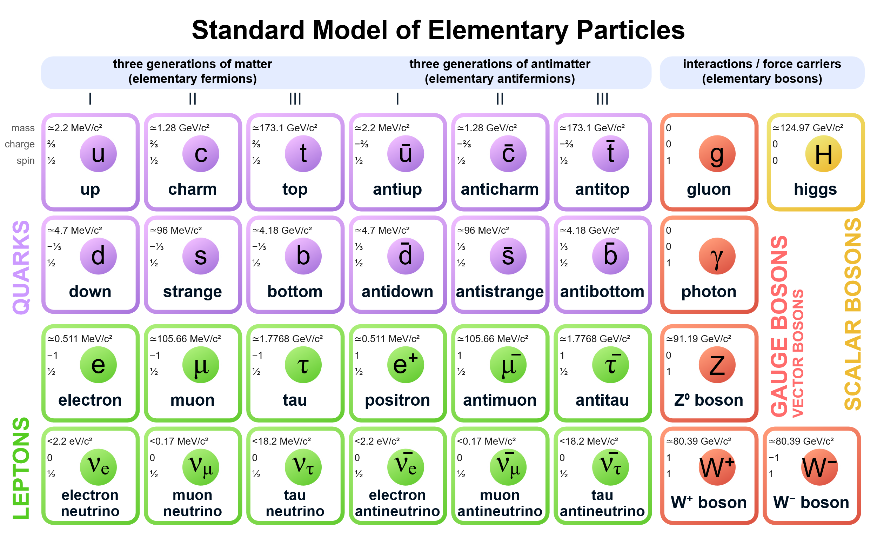
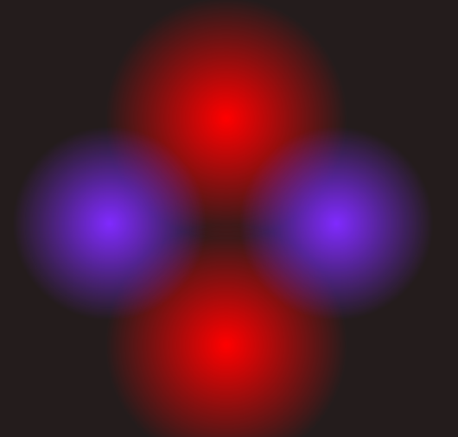
Atom
Nucleus
proton
neutron
Proton (Rutherford, 1919)
Neutron (Chadwick, 1932)
Electron

Slide 6
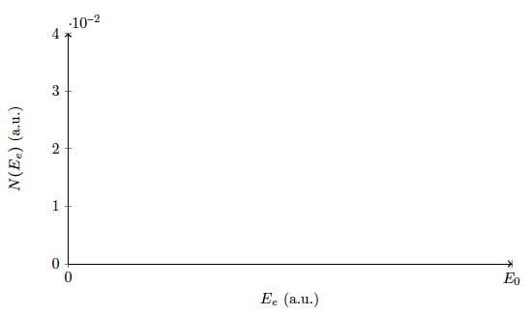
Expectation

Slide 7
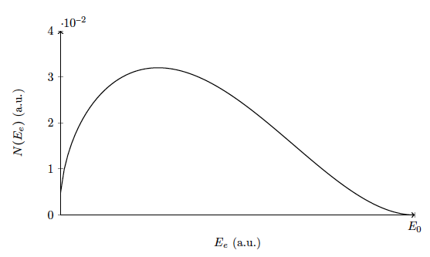
missing energy

Slide 8
The first time to propose a new particle to “cover up” for fundamental laws
I have done a terrible thing, I have postulated a particle that cannot be detected. —Pauli, 1930

Slide 9
Fundamental matter in our current world view:
Standard Model
3 generations?!

Slide 10
Fundamental matter in our current world view:
Standard Model
3 generations?!
Symmetric antimatter?

Slide 11
Neutrinos and antineutrinos in Standard Model
Charge neutral
Massless
How can we tell all 6 of them apart?

Slide 12
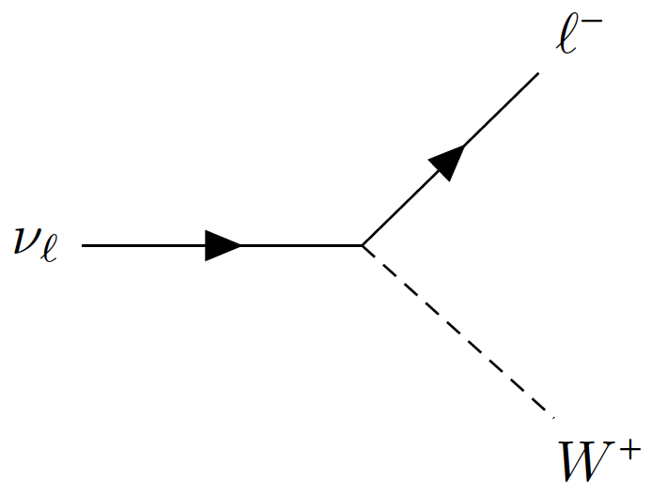

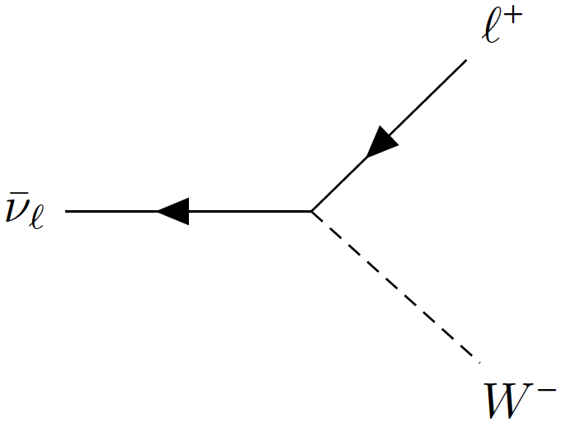
Neutrinos and antineutrinos in Standard Model
Charge neutral
Massless
How can we tell all 6 of them apart?
Flavour, defined by charged-current interactions

Slide 13
Neutrinos and antineutrinos in Nature
Charge neutral
Massless turns out to be tiny but not zero!
How can we tell all 6 of them apart? One more way (too many) to tell the neutrinos apart!
Flavour, defined by charged-current interactions

Slide 14
Neutrino Mass and Mixing
Standard Model
Beyond Standard Model
Mass “levels”
Pontecorvo–Maki–Nakagawa–Sakata
PMNS matrix
Normal / Inverted Mass Ordering (Hierarchy)
Mass gaps (Δm²) leads to neutrino flavour oscillations
Mark Thomson, Particle Physics lecture notes

Slide 15
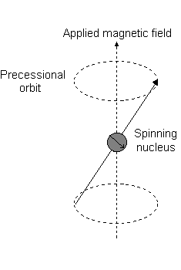

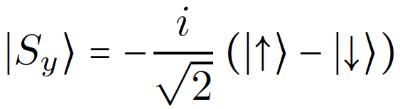
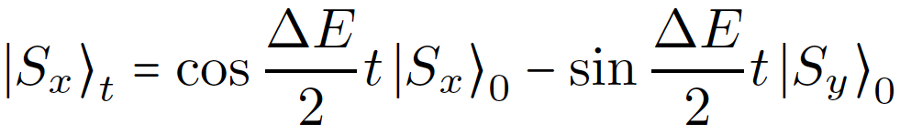
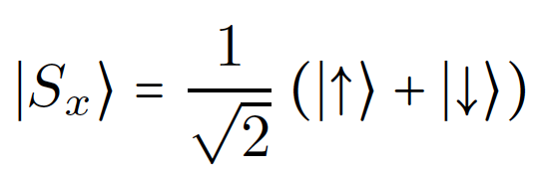
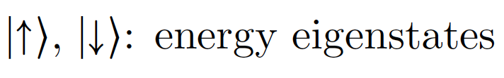
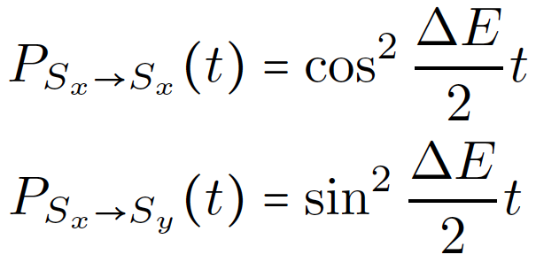
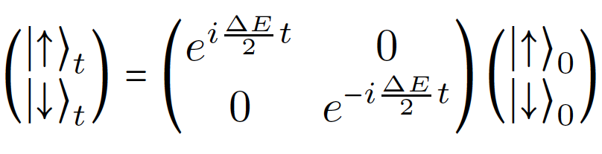
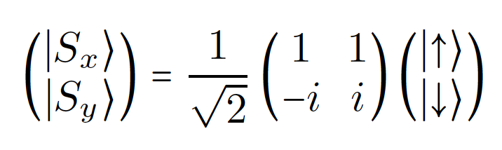
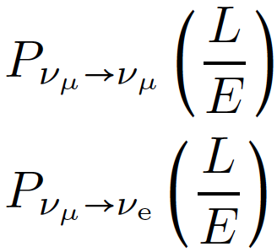
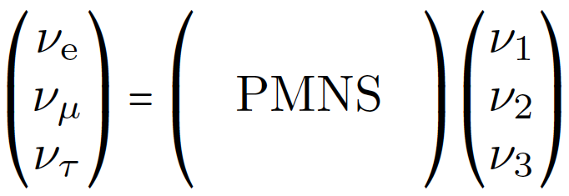


Analogy: spin rotation in a magnetic field
B$≠$0
B=0
y
ΔE
Oscillation probability
x
Image source: https://teaching.shu.ac.uk/hwb/chemistry/tutorials/molspec/nmr1.htm
Time evolution
Mixing
Survival
Appearance
Oscillation Phase: [E⁰]
  Δm²: [E²]
  L: propagation distance [E⁻¹]
  E: energy [E]
Phase ~ Δm²L/E

Slide 16
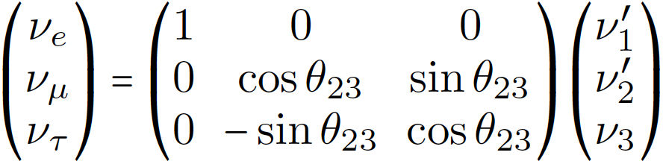
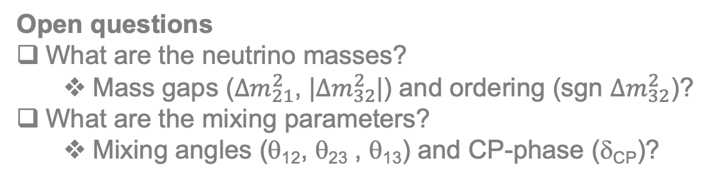
PMNS matrix
θ₁₃ ≠ 0 → δ_{CP} can be observed
Open questions
What are the neutrino masses?
  Mass gaps (${∆m}_{21}^{2}$, |${∆m}_{32}^{2}$|) and ordering (sgn ${∆m}_{32}^{2}$)?
What are the mixing parameters?
  Mixing angles (θ₁₂, θ₂₃ , θ₁₃) and CP-phase (δ_{CP})?
θ₁₂: mixing between ν₁ and ν₂
θ₂₃: mixing between ν_{μ} and ν_{τ}
θ₁₃: if 0, effective 2 flavour mixing

Slide 17






θ₁₃ = 0
Antineutrinos
2-flavor oscillation
$$νβ$$
$$\overline{ν}β$$
$$P(να)+P(νβ)=1$$
$$P(\overline{ν}α)+P(\overline{ν}β)=1$$
v_{μ}
$$να$$
$$\overline{ν}α$$
Oscillation as a function of time
line-in-line → same trivia

Slide 18








θ₁₃ ≠ 0
Antineutrinos
3-flavor oscillation
$$ντ$$
$$\overline{ν}τ$$
$$P(νe)+P(νμ)+P(ντ)=1$$
$$P(\overline{ν}e)+P(\overline{ν}μ)+P(\overline{ν}τ)=1$$
v_{μ}
$$νμ$$
$$\overline{ν}μ$$
$$νe$$
$$\overline{ν}e$$
Oscillation as a function of time
line-in-plane → CP-violation possible

Slide 19
PMNS
Trimaximal mixing
— maximally CP-violating

Slide 20
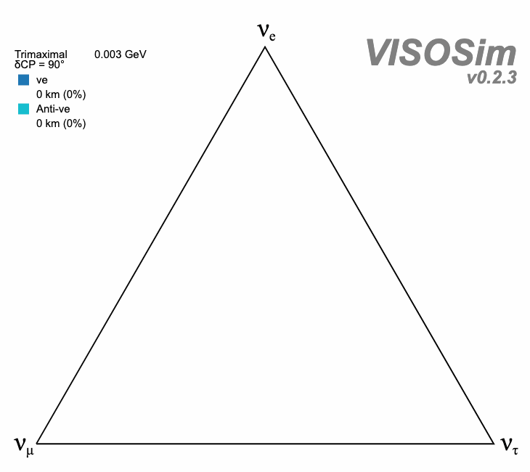
PMNS
Trimaximal mixing
— maximally CP-violating
☛ VISOS
Beautiful but not how Nature works ¯\_(ツ)_/¯

Slide 21
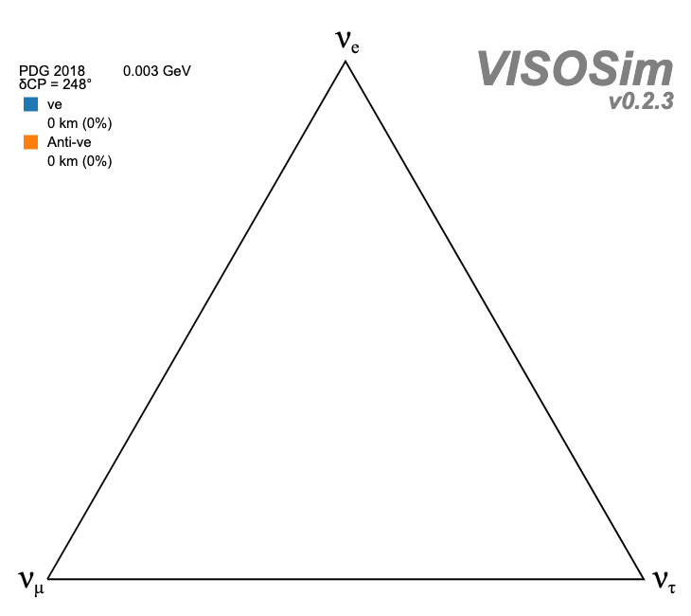
How Nature might work:
☛ VISOS

Slide 22
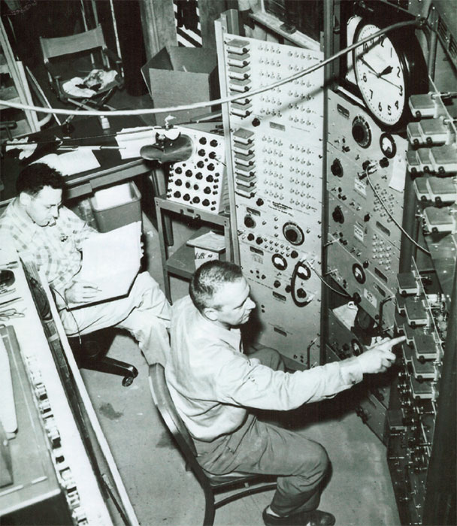
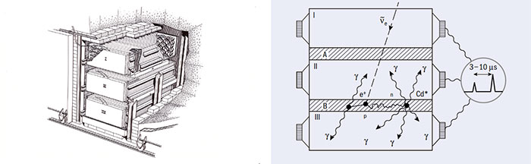
Nuclear reactor
MeV antineutrinos
Liquid scintillator
Water doped w/ cadmium
https://cerncourier.com/a/ghosts-in-the-machine/
Cowan–Reines Experiment, 1956
The first observation of neutrino interactions
Before that:
Some hand-waving and rough calculations led me to conclude that the bomb was the best source. –Reines, 1951

Slide 23
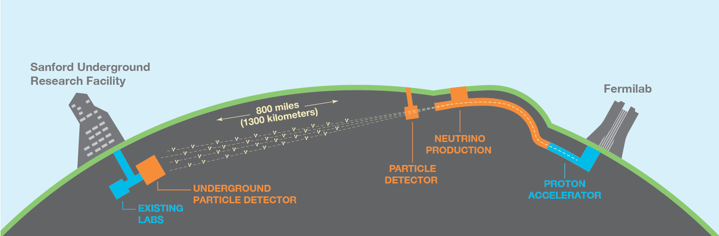

UNDER CONSTRUCTION
https://www.dunescience.org/
Travel 1/10 of Earth’s diameter
(baseline L ~ 1300 km)
[Physics Today 61, 5, 29 (2008)]
~ 3 GeV neutrinos and antineutrinos

Slide 24
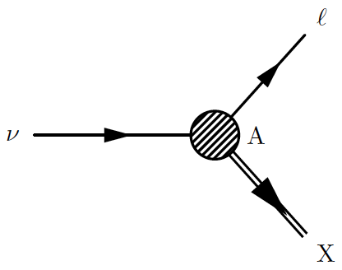
Charged lepton
—easy detection
—flavour oscillation tagging
Accelerator neutrino beam
GeV neutrinos and antineutrinos
—CP measurements
Target nucleus
Out-going hadrons

Slide 25
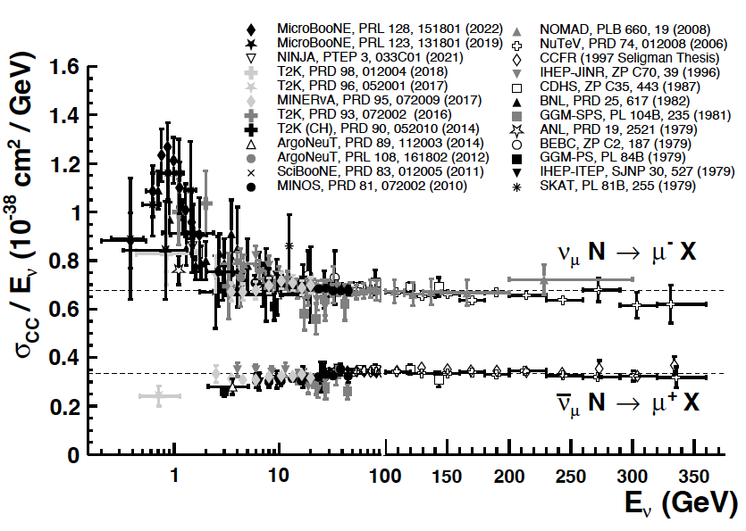
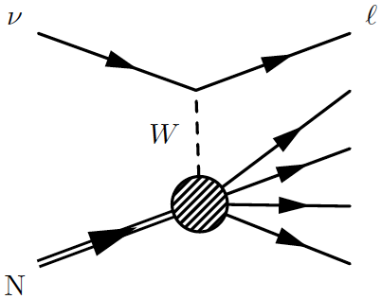
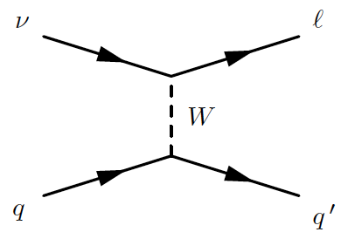
PDG, PTEP 2022, 083C01 (2022)
Deep Inelastic Scattering (DIS)
At high energy, ν interacting with quarks, $σ\sim E_{ν}$

Slide 26
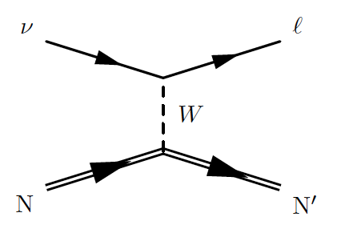
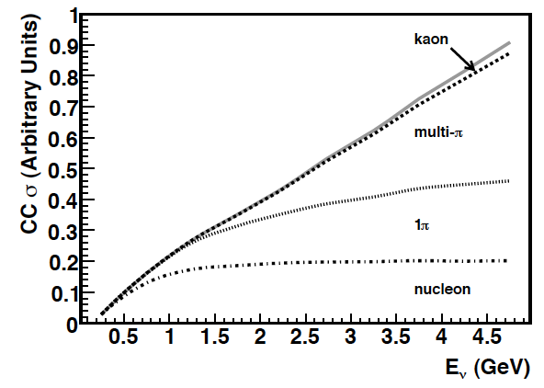
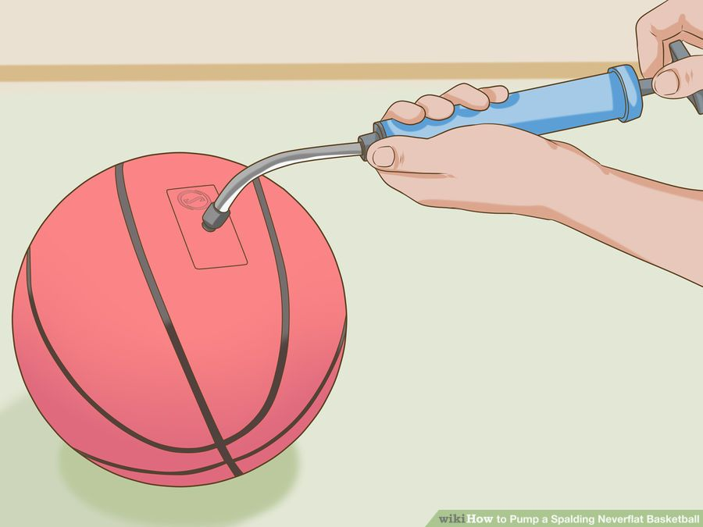
Quasielastic (QE)
Formaggio & Zeller, Rev. Mod. Phys. 84, 1307 (2012)
Final-state lepton takes away energy excess
σ_{QE} starts to saturate at 1 GeV
ν
l
N
Source: http://www.wikihow.com/Pump-a-Spalding-Neverflat-Basketball

Slide 27
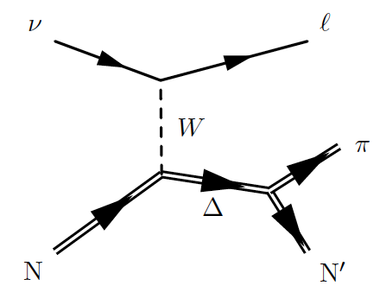
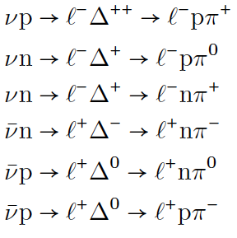
Resonant production (RES)
Formaggio & Zeller, Rev. Mod. Phys. 84, 1307 (2012)
Other resonances, e.g. N*
Non-resonant diagrams

Slide 28
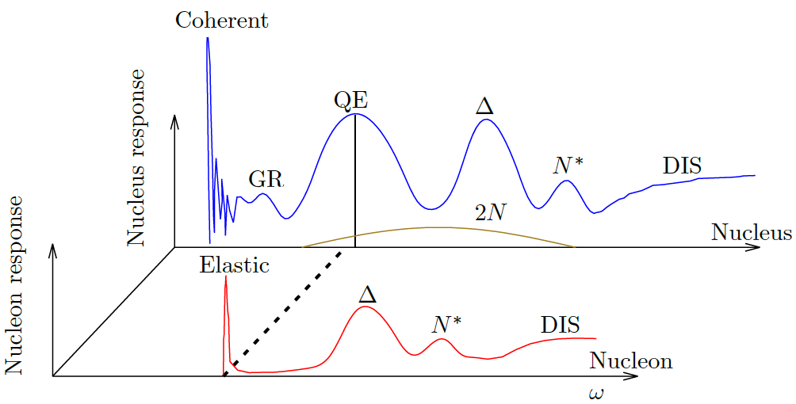
Collective effects
Fermi motion &
nuclear potential
2p2h?
Energy transfer from neutrino
Van Cuyck, PhD Thesis, Ghent University (2017)

Slide 29
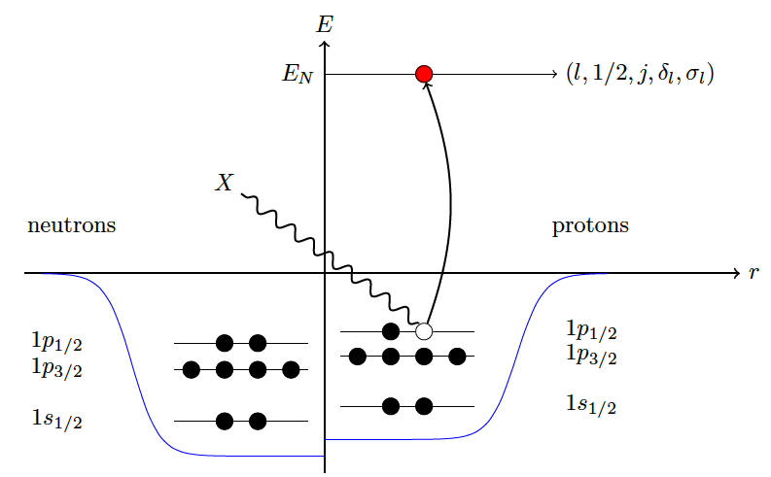
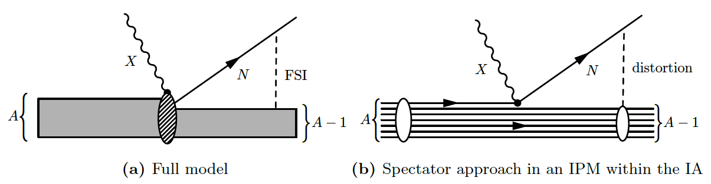
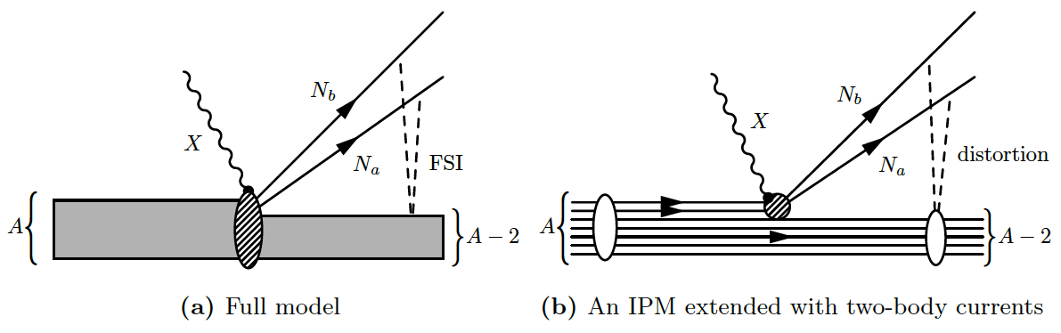
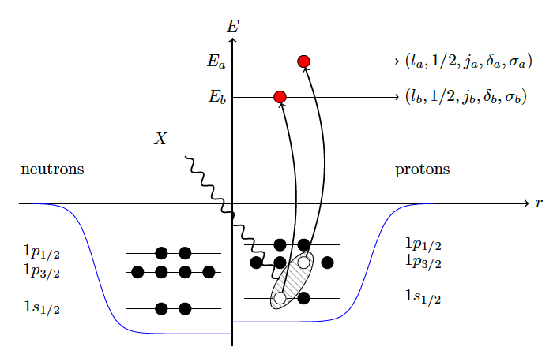
Impulse approximation (IA)
1-particle-1-hole
(1p1h)
1-body current
continuum
Residual nucleus
2-particle-2-hole
(2p2h)
2-body current
continuum
Residual nucleus
All figures from Van Cuyck, PhD Thesis, Ghent University (2017)

Slide 30
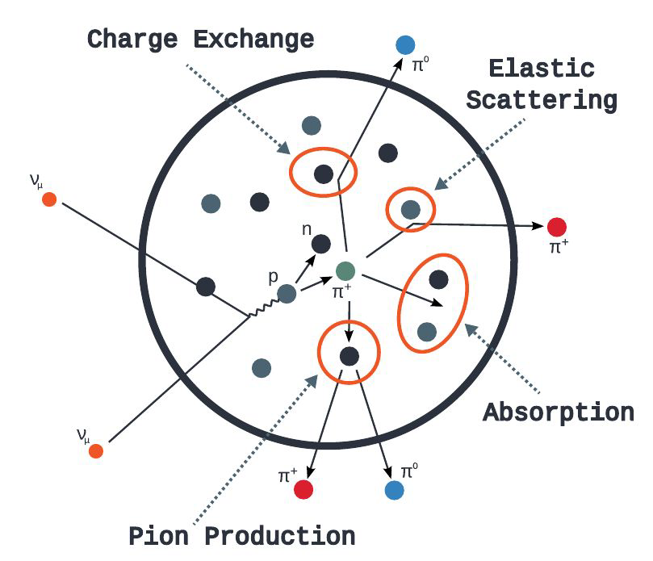
Final-state interaction (FSI)
π
Van Cuyck, PhD Thesis, Ghent University (2017)
Golan, Trento, 2018

Slide 31
Final-state interaction (FSI)
Can not identify RES experimentally
π
Van Cuyck, PhD Thesis, Ghent University (2017)
Golan, Trento, 2018

Slide 32
Why Neutrino Interactions?
How well can we measure neutrino energy?
(reminder: oscillation very sensitive to baseline and energy, L/E)
2-body reaction
precise
Fermi motion,
Final State Interaction (FSI)
spread
V. Cuyck
Martini et al., Phys.Rev. D87, 013009 (2013)
V. Cuyck
2-particle-2-hole (2p2h),
pion absorption (missing particles)
Large fraction of large bias and spread

Slide 33
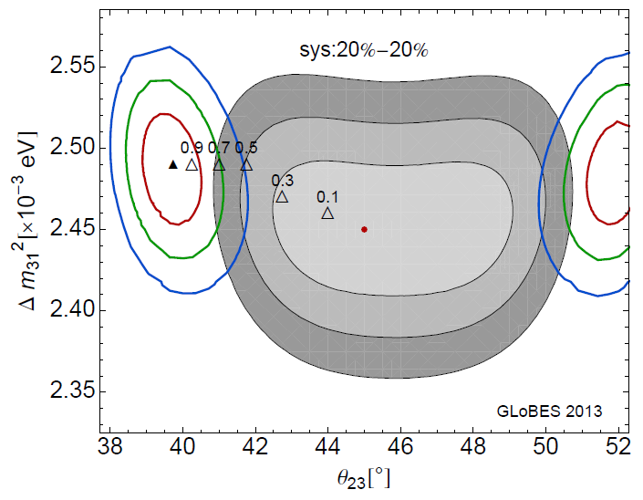
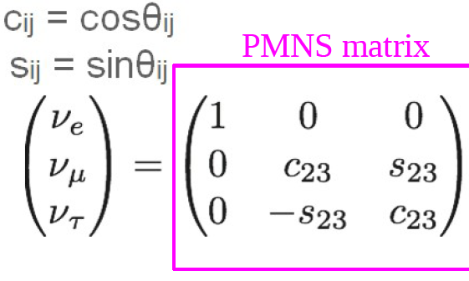
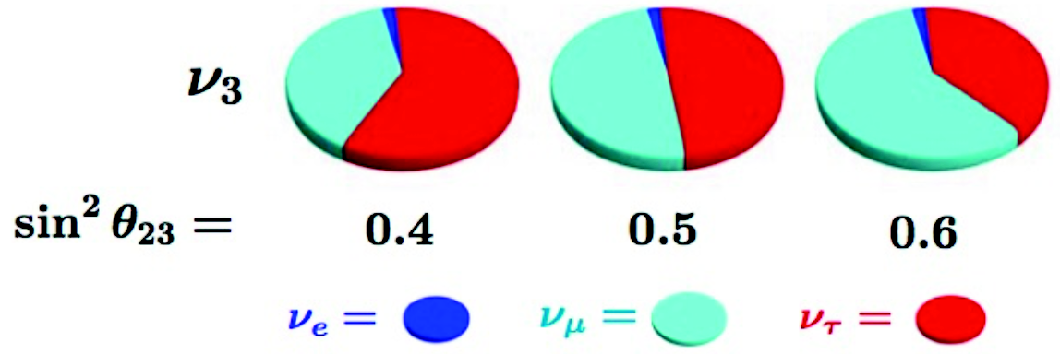
Intranuclear Dynamics and Neutrino Oscillation Measurements
Coloma & Huber, Phys.Rev.Lett. 111, 221802 (2013)
Mixing between
μ and τ flavors
Mock measurement with
perfect knowledge of interactions
Parke, 1801.09643

Slide 34
Intranuclear Dynamics and Neutrino Oscillation Measurements
Coloma & Huber, Phys.Rev.Lett. 111, 221802 (2013)
Mixing between
μ and τ flavors
Mock measurement with
ignoring nuclear effects of interactions
Parke, 1801.09643

Slide 35
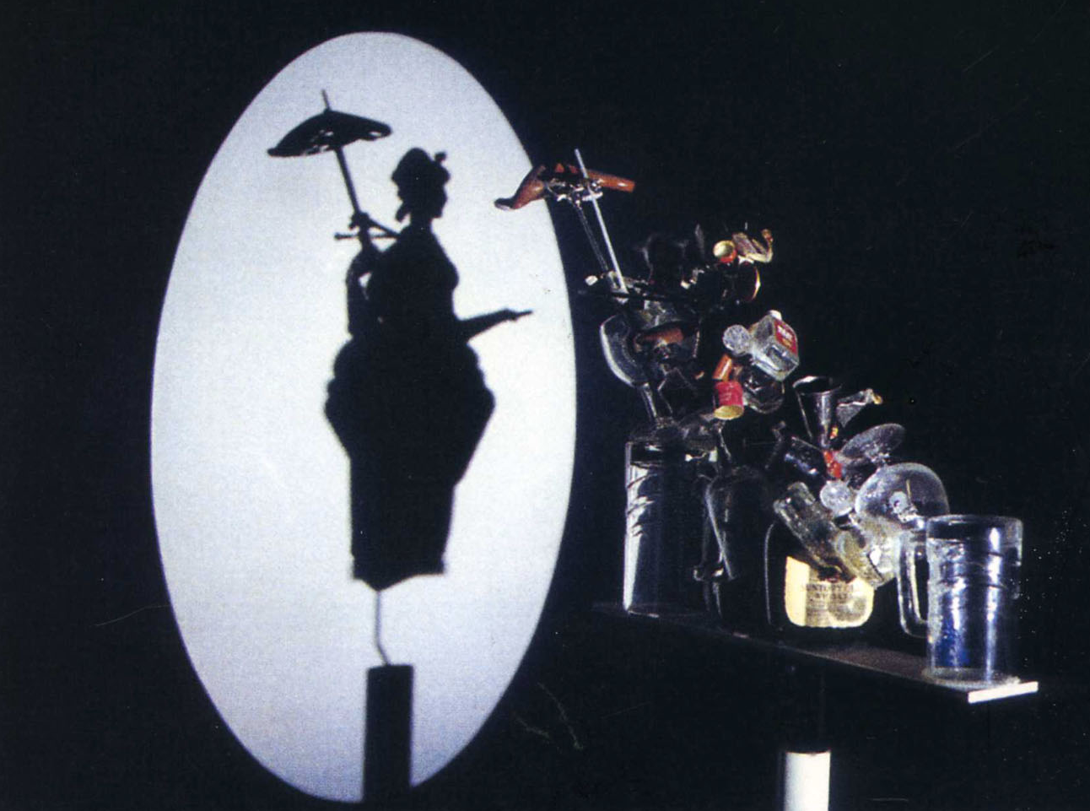
©Shigeo Fukuda

Slide 36
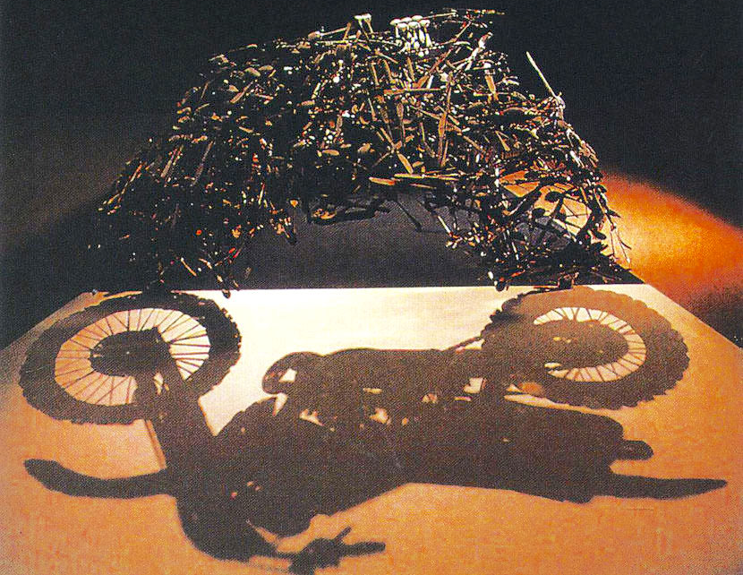
©Shigeo Fukuda

Slide 37

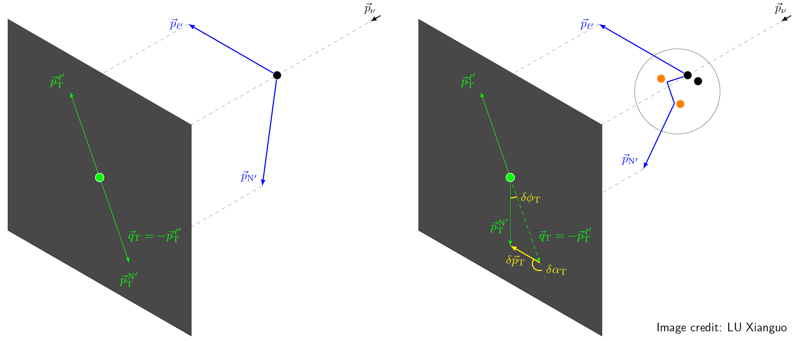
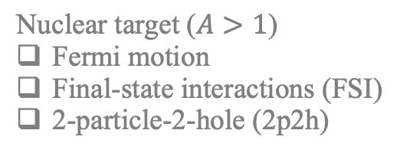
Transverse Kinematic Imbalance (TKI)
[…]
[…]
TKI
Multi-dimensional observation
Momentum (magnitude)
Angle
Asymmetry
Stationary free nucleon target
Nuclear target ($A>1$)
Fermi motion
Final-state interactions (FSI)
2-particle-2-hole (2p2h)
Lu, et al., Phys.Rev.D 92, 051302 (2015)
Lu, et al., Phys.Rev.C 94, 015503 (2016)
Lu & Sobczyk, Phys.Rev.C 99, 055504 (2019)
Cai, Lu, Ruterbories, Phys.Rev.D 100, 073010 (2019)

Slide 38

TKI Measurements
E_{ν} ~ 3 GeV
E_{ν} ~ 0.6 GeV
Boosting
Dragging
Dissipative processes: 2p2h, FSI

Slide 39

TKI Measurements
W. Chang
Boosting
Dragging
Dissipative processes: 2p2h, FSI
Dynamical evolution of nuclear medium effects can be mapped out via beam energy scan at nuSTORM

Slide 40




Accelerator Neutrino Experiments
T2K / Hyper-K
NOvA
T2K
NOvA
ν beams via hadron decay
DUNE
DUNE

Slide 41
Accelerator Neutrino Experiments
T2K / Hyper-K
NOvA
T2K
NOvA
Near Detectors to constrain ν flux and cross section together (no oscillation)
DUNE
DUNE

Slide 42
Accelerator Neutrino Experiments
T2K / Hyper-K
NOvA
T2K
NOvA
Far Detectors to measure ν oscillation
DUNE
DUNE

Slide 43


Accelerator Neutrino Experiments
Accelerator ν Experiment | $Eν$/GeV @ Flux Peak | Far Detector Technology | Target Nuclei
T2K / Hyper-K | 0.6 | Water Cherenkov | H₂O
NOvA | 2 | Liquid Scintillator | CH
DUNE | 2.4 | LAr TPC | Ar
Signal = (Beam flux $∙$ Oscillation probability $∙$ Cross section) $⨁$ Detector effects
Beam: $νμ$ and $\overline{ν}μ$
Oscillation
  $νμ$ and $\overline{ν}μ$ disappearance (most oscillated to $ντ$ and $\overline{ν}τ$)
  $νe$ and $\overline{ν}e$ appearance, then CP violation

Slide 44




Accelerator Neutrino Experiments
T2K flux
T2K, Phys.Rev.Lett. 116, 181801 (2016)
LBNF
“β decay” of collision products
(ν_{μ} from π, ν_{e} from K)
Neutrino beams from accelerators
→ Directional
Charge selection on π
→ High purity $ν$ or $\overline{ν}$ beams
Maximise $νμ$ and $\overline{ν}μ$ flux

Slide 45


Accelerator Neutrino Experiments
T2K flux
T2K, Phys.Rev.Lett. 116, 181801 (2016)
LBNF
“β decay” of collision products
(ν_{μ} from π, ν_{e} from K)
Neutrino beams from accelerators
→ Directional
Charge selection on π
→ High purity $ν$ or $\overline{ν}$ beams
Maximise $νμ$ and $\overline{ν}μ$ flux
Minimise $νe$ and $\overline{ν}e$ to observe appearance
  $νe$ and $\overline{ν}e$ flux are background

Slide 46




Call for a GeV $ν$_{e} and $\overline{ν}$_{e} Machine
Oscillation Signal = (Beam flux $∙$ Oscillation probability $∙$ Cross section) $⨁$ Detector effects
Jeanne Wilson, Neutrino2022
$νe$ ($\overline{ν}e$) cross sections: major $δCP$ systematics
Very few $νe$ scattering data
$δCP$ ~ $νe$ appearance ~ no $νe$ in beams
  No in situ $νe$ measurements
$νμ$ for $νe$ via lepton universality, but higher precision needed for $δCP$
Hyper-K example
Improving error of $νe$/$\overline{ν}e$ xsec ratio 4.9% → 2.7%
Improve $δCP$ sensitivity by ~ 1 σ for 6 year
Significantly shorten running time to reach 5σ
Host
Cost
Cost
Time

Slide 47
Call for a GeV $ν$_{e} and $\overline{ν}$_{e} Machine
Oscillation Signal = (Beam flux $∙$ Oscillation probability $∙$ Cross section) $⨁$ Detector effects
Jeanne Wilson, Neutrino2022
$νe$ ($\overline{ν}e$) cross sections: major $δCP$ systematics
Very few $νe$ scattering data
$δCP$ ~ $νe$ appearance ~ no $νe$ in beams
  No in situ $νe$ measurements
$νμ$ for $νe$ via lepton universality, but higher precision needed for $δCP$
Hyper-K example
Improving error of $νe$/$\overline{ν}e$ xsec ratio 4.9% → 2.7%
Improve $δCP$ sensitivity by ~ 1 σ for 6 year
Significantly shorten running time to reach 5σ
Shorten running time = reduce share cost
Host
Cost
Co-Host
Cost
Time

Slide 48


Call for a GeV $ν$_{e} and $\overline{ν}$_{e} Machine
Oscillation Signal = (Beam flux $∙$ Oscillation probability $∙$ Cross section) $⨁$ Detector effects
$νe$ ($\overline{ν}e$) cross sections: major $δCP$ systematics
Very few $νe$ scattering data
$δCP$ ~ $νe$ appearance ~ no $νe$ in beams
  No in situ $νe$ measurements
$νμ$ for $νe$ via lepton universality, but higher precision needed for $δCP$
Wishlist
  $νe$ and $\overline{ν}e$ beams with the relevant energy for appearance
  Well-understood fluxes
  High statistics
  Low $νμ$ background
Shorten running time = reduce share cost
Host
Cost
Co-Host
Cost
Time

Slide 49




$ν$ from STORed Muons (nuSTORM)
LBNF
nuSTORM, arXiv:2203.07545
π captured by storage ring → μ, instead of decay pipe → ν
$\overline{ν}μ\text{+}νe$and $νμ$+$\overline{ν}e$ fluxes from $μ^{±}$ decays
  Storage ring: tunable fluxes
  μ decay: perfect understanding of flux shape and normalisation
Scientific objectives
  %-level $ν$ cross sections
  BSM searches, e.g. steriles beyond Short Baseline Neutrino program at FNAL
  Test bed for muon collider technology

Slide 50


$ν$ from STORed Muons (nuSTORM)
Fixed Field Alternating gradient (FFA) lattice
Improve acceptance of muon
FODO lattice
Minimise dispersion
J. Pasternak, J.B.Lagrange
Production Straight
Return
Arc
Return
Arc
Return Straight
1st ν beam facility & highest ever beam power based on stored muons
Fine tune neutrino fluxes via $μ$ acceptance
  p_{μ} mean: neutrino beam energy scan (νBES)
    Tunable between 1 and 6 GeV/c, spread ±16%
  p_{μ} spread: flux shape

Slide 51


A Brief History of nuSTORM
CERN-PBC-REPORT-2019-003
DOI:10.17181/CERN.FQTB.O8QN
2012-13 LoI and Proposal to FNAL PAC [arXiv:1206.0294, arXiv:1308.6822], EoI to CERN [arXiv:1305.1419]
      Sterile neutrinos
      Neutrino-nucleus scattering
      Technology test bed for muon accelerators
2014 Steriles sensitivity [Phys.Rev.D 89, 071301 (2014)]
      nuSTORM at FNAL
2019 Feasibility of nuSTORM at CERN [CERN-PBC-REPORT-2019-003]
      SPS 100 GeV proton beam
      Optimised for neutrino-nucleus scattering, maintaining sensitivity to BSM (steriles + non-unitarity, NSI, Lorentz-invariance/CPT violation)
2022 Snowmass 2021 [arXiv:2203.07545]
      Advocating synergy with ENUBET and Muon Collider Demonstrator
        Muon Collider demonstrator
          6-D cooling
        nuSTORM as test bed for muon storage ring
          Complete implementation for large acceptance
          R&D for very precise determination of stored-muon energy and spread
2025 On-going: European Strategy Update for Particle Physics
      Submission: https://indico.cern.ch/event/1439855/abstracts/191113/
Why do we need nuSTORM?
What other physics can we do with it?

Slide 52

Summary
Neutrino
  cover up for missing energy in the `30s
Neutrino mass and flavour oscillation
  one-too-many identity crisis
Neutrino interaction
  Interacting is believing
TKI
  Transverse Kinematic Imbalance (transverse missing energy for nuclear effects)
  Neutrino shadow play
nuSTORM
  ν from STORed Muons
  A unique GeV $ν$_{e} and $\overline{ν}$_{e} machine for the future

Slide 53
BACKUP

Slide 54
Summer Blot, Neutrino 2020
Oscillation Phase ~ Δm²L/E
Small Δm²
Only two Δm²
Large Δm²
Normal
Inverted

Slide 55

Transverse Boosting Angle δα_{T}
δα_{T} is Fermi motion direction → isotropic
—total transverse momentum
—transverse momentum imbalance
—missing pT
—...
In full
FSI and missing particles

Slide 56
Transverse Boosting Angle δα_{T}
FSI and momentum sharing with extra particles
pion absorption
2p2h

Slide 57


Detector
Sensing $ν$ interactions
Embedded in detector, incomplete particle information
Tracking/Cherenkov threshold
Angular acceptance
Particle Identification (PID)
Neutrals
Noise
Proton Range (Range: how far a particle can travel in a medium)
vs
Kinetic Energy
Hamacher-Baumann, Lu, and Martín-Albo, Phys. Rev. D 102, 033005 (2020)
Sensor granularity
~ mm-cm
10 bar gas
Tracking threshold
(no momentum measurement possible below it)
~ few MeV for 10 bar gas
~ 10s MeV for liquid/solid
liquid/solid

